Slide 1
PGVCL Training
Day-8

Slide 2
Flutter Training for PGVCL Department
Day 8 : Network Requests and Offline Database

Slide 3
Overview
Topics We’ll Be Covering For Today
Theory
Making HTTP requests in Flutter.
Using SQLite/Hive for offline storage
Practical
Create an app that fetches data from a REST API and stores it locally
Assignment
Implement a feature to sync offline changes when connected to the internet.

Slide 4
Objectives
Understand the basics of making HTTP requests in Flutter
Explore offline storage options such as SQLite and Hive.
Implement a practical app that fetches data from an API and stores it locally for offline access.

Slide 5
Making HTTP Requests in Flutter
Definition: HTTP requests allow apps to communicate with servers for retrieving or sending data.
Key Concepts:
HTTP Methods:
GET: Retrieve data from the server.
POST: Send new data to the server.
PUT: Update existing data on the server.
DELETE: Remove data from the server.

Slide 6
Packages Used:
http: A simple package for making HTTP requests.
dio: Advanced HTTP client with features like interceptors and file uploads.
Common Use Cases:
Fetching news articles from an API.
Sending form data to a server.

Slide 7
Understanding Offline Storage
What Is Offline Storage?
A mechanism to save data locally on the device to ensure availability without an internet connection.
Why Is It Important?
Improves User Experience: Users can access data anytime, even offline.
Reduces Server Load: Data is cached or stored locally, minimizing network calls.
Enhances App Performance: Faster data retrieval from local storage.

Slide 8
Offline Storage Options in Flutter
SQLite:
Relational database for structured data.
Useful for apps requiring complex queries.
Example: Storing user profiles or order histories.
Hive:
Lightweight NoSQL database.
Best for key-value pair storage and high-speed performance.
Example: Caching user preferences or API responses.

Slide 9
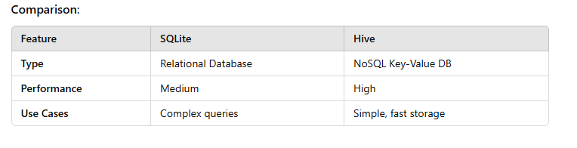
Comparison:

Slide 10
Practical: REST API and Offline Storage
Objective: Build a Flutter app with the following features:
Fetch data from a REST API (e.g., JSONPlaceholder or OpenWeatherMap).
Parse the JSON response and display it in a list.
Store the data locally using SQLite or Hive.
Load the data from local storage when the app is offline.
Steps:
Set up API integration using the http package.
Use sqflite or hive to store data locally.
Implement conditional logic to check connectivity and load data.
Test the app in both online and offline modes.

Slide 11
Best Practices for HTTP Requests
Use async/await for non-blocking network calls.
Handle network errors gracefully with try-catch blocks.
Validate and parse JSON responses efficiently.
Avoid unnecessary API calls by caching data.
Use secure communication protocols (e.g., HTTPS).

Slide 12
Best Practices for Offline Storage
Choose the right database based on your app’s needs.
Use clear and organized models for data representation.
Implement data syncing strategies for consistency.
Test offline functionality thoroughly for a seamless experience.

Slide 13
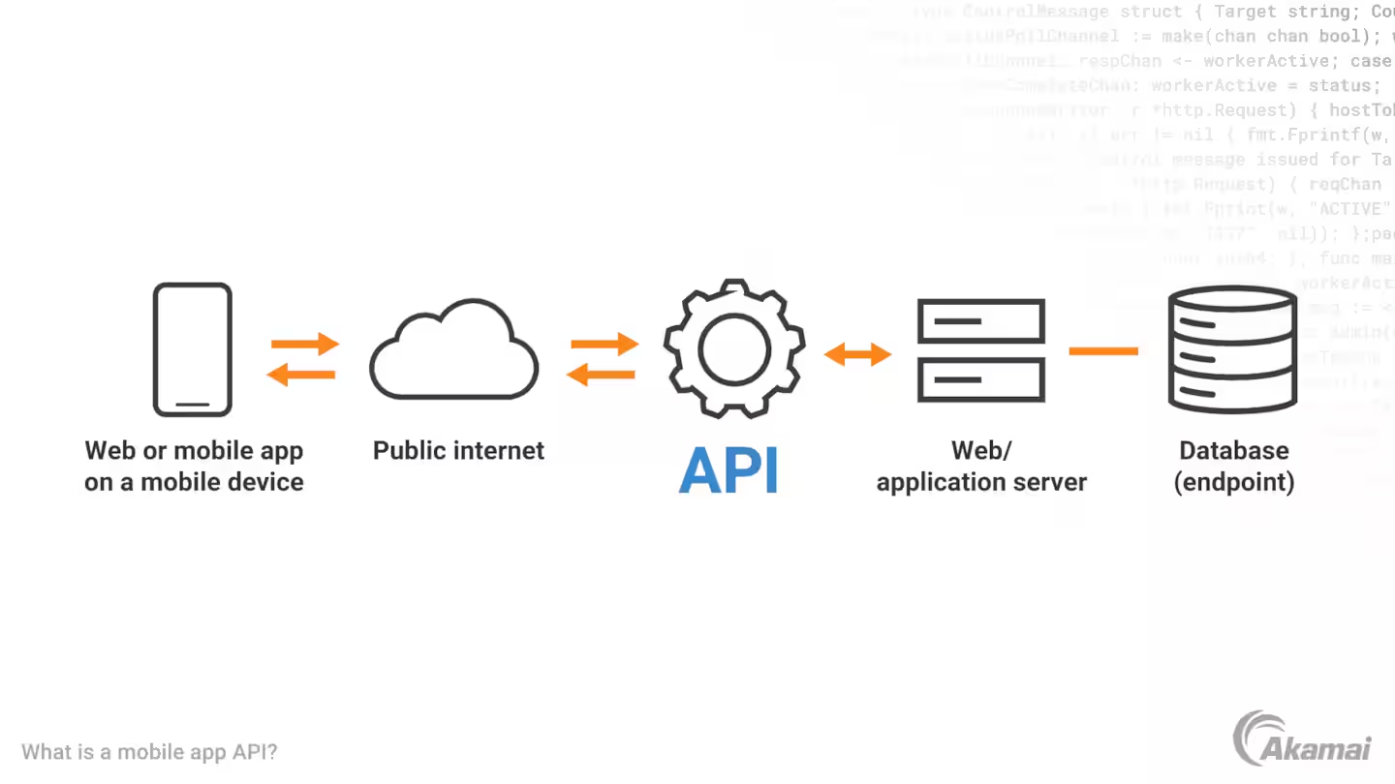

Slide 14
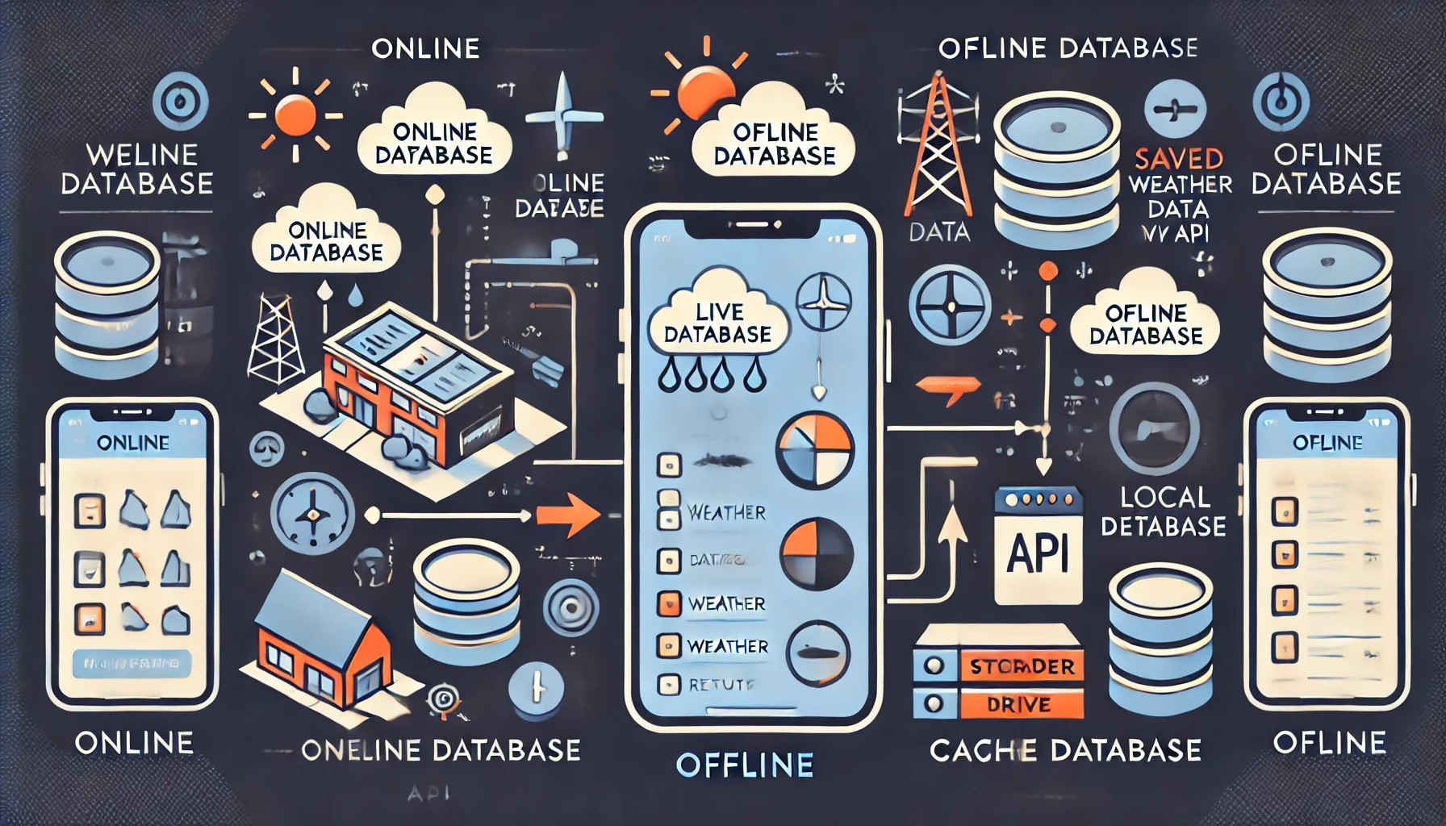

Slide 15
Practical Example
Link
Assignment Example
Create a basic UI with 3 Stateless Widgets and 2 Stateful Widgets

